Slide 1
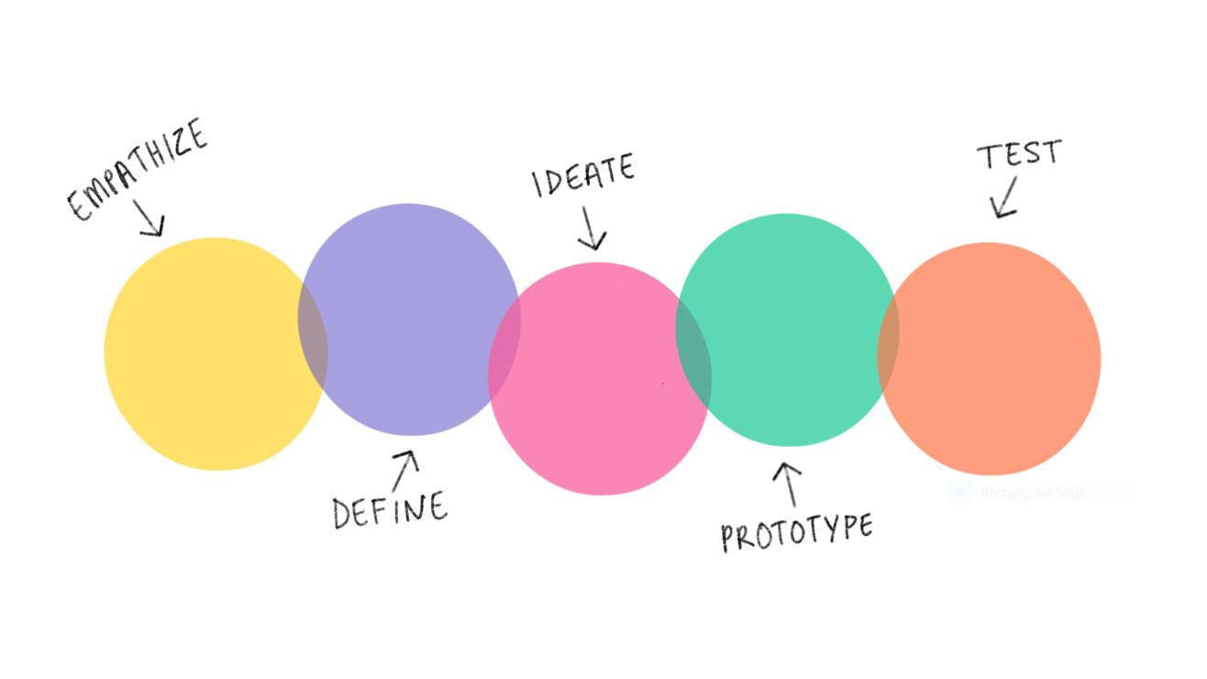
Jarvis x spotify
2
+
2
+
Oz, Luke & Cerys

Slide 2


Jarvis
2
+
2
+
2
+
Who/What is JARVIS?

Slide 3
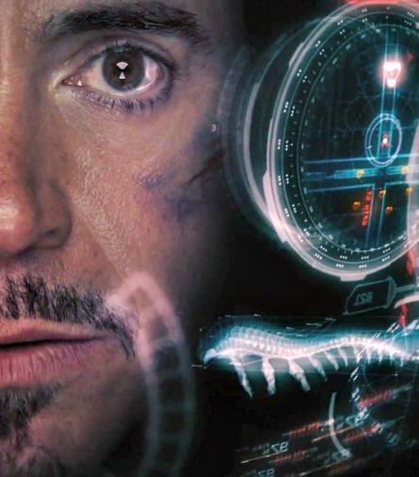
Jarvis & tony
2
+
2
+
How they interact?
Affordance – relationship between how an object and a user interact
Signifier – communicates the affordance to the user
Feedback – communicates an action you expect to happen as a consequence of the user’s interaction
https://www.fandango.com/movie-news/mark-zuckerberg-is-building-a-real-life-jarvis-just-like-tony-stark-in-the-iron-man-movies-750308

Slide 4

Don norman – The design of everyday things
Design Thinking
Human-centered design (HCD)
Find the root issue
Make multiple solutions
Propose the best solution
“Solving the right problem, and doing so in a way that meets human needs and capabilities”
“A brilliant solution to the wrong problem can be worse than no solution at all”

Slide 5
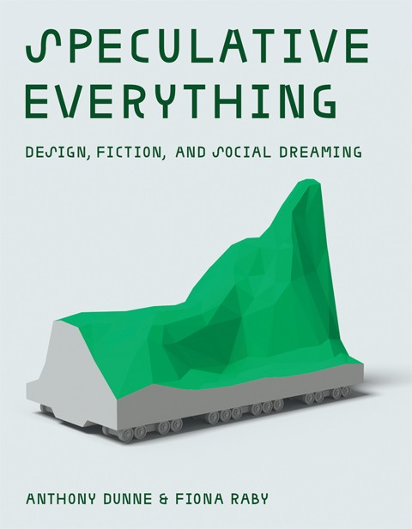
Speculative design
2
+
2
+
“Unsettle the present”
Addressing big societal problems and looking towards the future.
Introducing the concept of ‘Radical Design’ – A design that introduces a new way of seeing or perceiving a current societal situation
JARVIS exposes the world to new opinions regarding the ever-growing current fear of A.I ‘over-taking’ or simply running our lives.
Disrupts the present through the realism of Artificial Intelligence, JARVIS’ ability to talk and think for ‘himself’ making the prospect of him and others a-like seem more likely to happen.

Slide 6
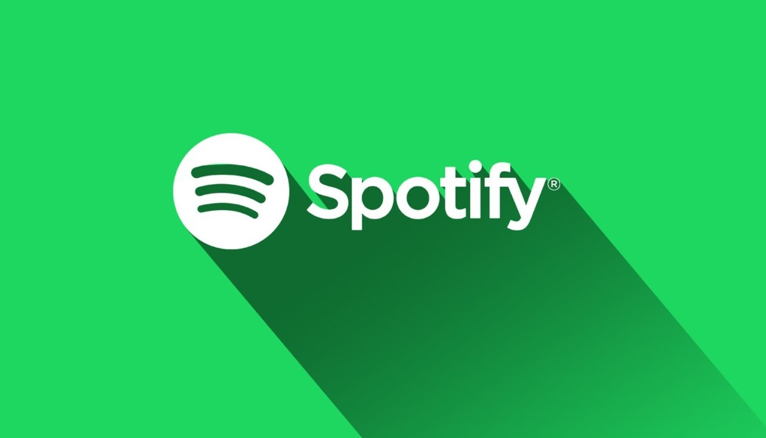
Spotify
2
+
2
+
History, Competitors, Future

Slide 7
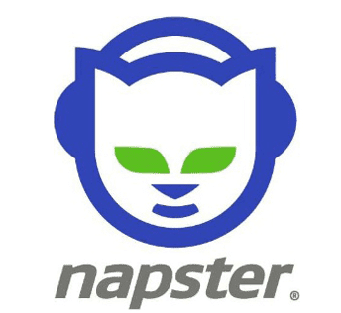
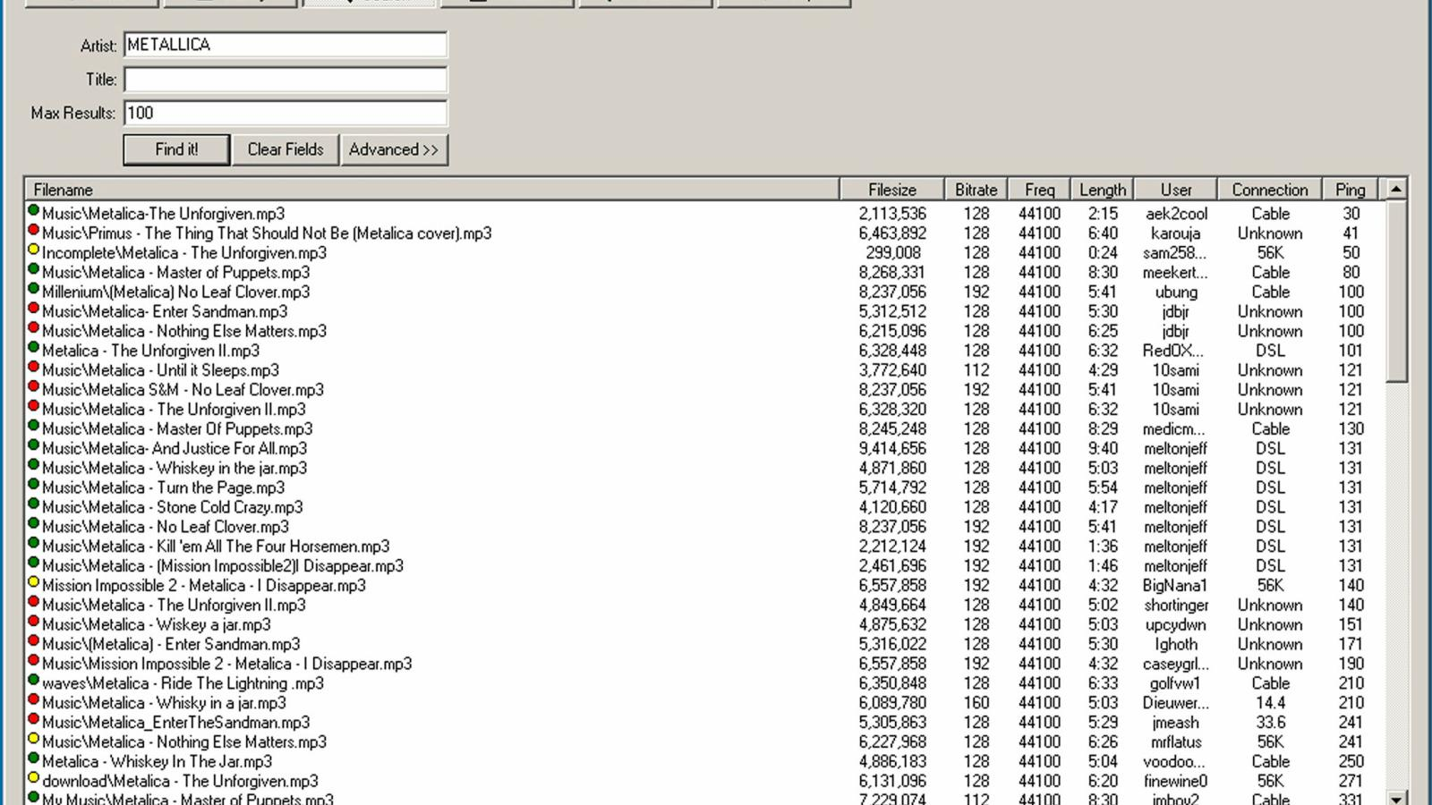
Napster and music services
2
+
Changing the music industry
Developed in 1998
Music became more accessible - download induvial songs instead of buying a whole album
70 million members by 2001
CD stores lost revenue and shut down
Itunes founded in 2003 – made distribution easier and cheaper

Slide 8
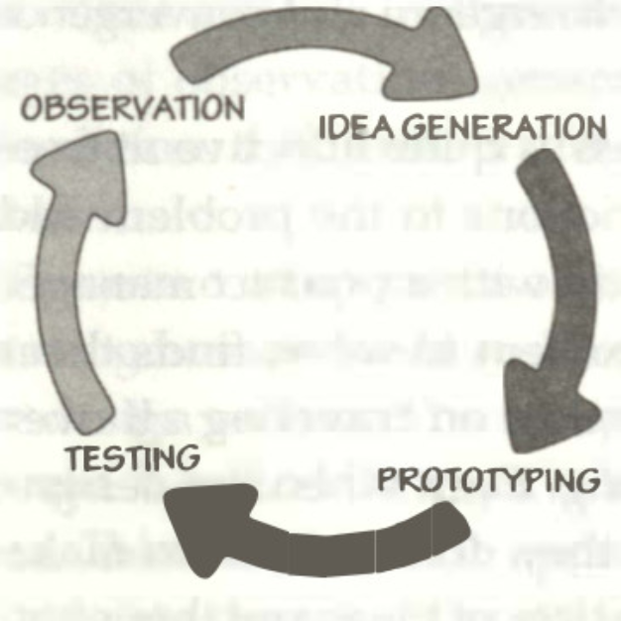
Founding
Speculative Design
Founded in 2006
Streaming service
Provided a solution for music records which were suffering from illegal downloads
Only available in 6 large European Countries on launch
Went through a lot of prototypes/trials before going onto other countries for full release
The iterative cycle of human design – Design of Everyday Things – Don Norman

Slide 9
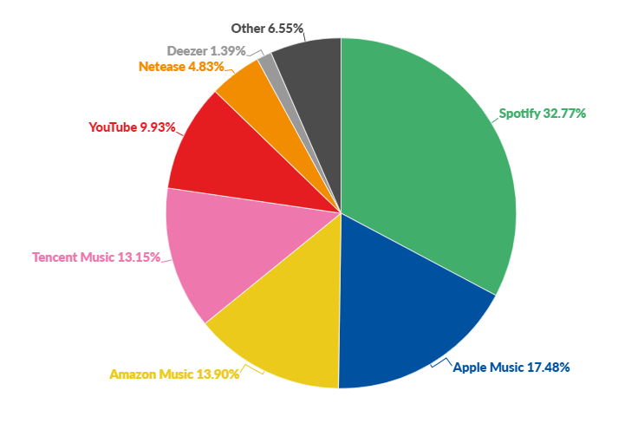
competitors
Revenue/Problems
Main Competitors: Apple Music, YouTube Music & Amazon Music.
Majority of revenue from subscriptions.
Free version brings revenue through Ads
Spotify as a Monopoly:
What is a Monopoly?
A company or business having exclusive control over a specific service.
Strong monopoly shown through monthly listeners
Also holds a monopoly over the “new” concept of ‘Streaming music on the Go’.
Graph from BusinessofApps

Slide 10

Future plans
2
+
How can it stay number one?
Needs to stay on top of the industry
Newly introduced: Podcasts of all kinds (learning, languages, entertainment etc.)
The service requires expansion to uphold its monopoly of music streaming services.

Slide 11
Spotify References
The Spotify Effect: Digital Distribution and Financial Growth https://journals-sagepub-com.ezproxy.uwe.ac.uk/doi/full/10.1177/1527476417741200?utm_source=summon&utm_medium=discovery-provider
Spotify financial results show struggle to make streaming music more profitable (BIBLIOGRAPHY FROM THE SPOTIFY EFFECT)
https://www.theguardian.com/technology/2015/may/11/spotify-financial-results-streaming-music-profitable
The Use of Social Media for Artist Marketing: Music Industry Perspectives and Consumer Motivations: https://www.tandfonline.com/doi/full/10.1080/14241277.2012.755682
Algorithmic Effects on the Diversity of Consumption on Spotify:
https://dl.acm.org/doi/abs/10.1145/3366423.3380281
Music Personalization at Spotify:
https://dl.acm.org/doi/abs/10.1145/2959100.2959120
Apple Music vs Spotify:
Apple Music vs Spotify – SoundGuys
Let’s Keep Music Special. F-Spotify.
https://webpebscohostcom.ezproxy.uwe.ac.uk/ehost/detail/detail?vid=0&sid=09e0249c94054ee180b1a63b4ce4eda4%40redis&bdata=JnNpdGU9ZWhvc3QtbGl2ZQ%3d%3d#AN=127873367&db=bth
Napster Documentary: Culture of Free | Retro Report | The New York Times:
https://www.youtube.com/watch?v=CKrdsGdLVQ8
How Spotify Dominates Apple, Google and Amazon in Music
https://www.youtube.com/watch?v=6viSSo12-PQ&list=WL&index=13
Spotify - Why They’re Successful
https://www.youtube.com/watch?v=PBoz2XigTFA&list=WL&index=14
BusinessofApps
https://www.businessofapps.com/data/music-streaming-market/
BBC – How Spotify came to be worth millions
https://www.bbc.co.uk/news/newsbeat-43240886#:~:text=Founded%20by%20Daniel%20Ek%20and,the%20music%20 industry%20was%20facing.
Spotify
https://spotify.design/team/

Slide 12
J.A.R.V.I.S References
Ironman Fandom
https://ironman.fandom.com/wiki/J.A.R.V.I.S.
J.A.R.V.I.S Fandom J.A.R.V.I.S. | Marvel Cinematic Universe Wiki | Fandom
Marvel Movies Fandom Just A Rather Very Intelligent System | Marvel Movies | Fandom
Marvel Fandom page https://marvel.fandom.com/wiki/Marvel_Database

Slide 13

Any questions?
2
+
2
+

